Slide 1
Gym Performance Dashboard
Created by: Sejal Mourya

Slide 2
Project Overview
The objective of this project is to analyze gym performance data and create an interactive dashboard that provides insights into:
Member attendance trends
Workout preferences
Demographic behavior
Membership type distribution
This dashboard helps in understanding overall gym engagement and supports data-driven decision-making.

Slide 3
Tools & Techniques
Tools Used:
Tableau Public – for interactive dashboard creation and data visualization
Microsoft Excel – for data cleaning and basic preprocessing
Techniques Applied:
Data cleaning and transformation
KPI creation using calculated fields
Use of filters for interactive data exploration
Dashboard layout design and data storytelling

Slide 4
Dataset Description
The dataset includes:
Member Gender
Age Group
Workout Type
Membership Type
Calories Burned
Workout Duration
Visit Date / Month
The data was cleaned and transformed to ensure accuracy and consistency before visualization.

Slide 5
Problem Statement
Fitness centers collect large volumes of data related to member visits, workout activities, demographics, and memberships. However, this data is often scattered and difficult to analyze, making it challenging for gym owners and managers to gain clear insights.
The objective of this project is to transform raw gym data into an interactive and visually intuitive dashboard using Tableau Public, enabling stakeholders to track gym performance, understand member behavior, identify workout trends, and support data-driven decision-making.

Slide 6
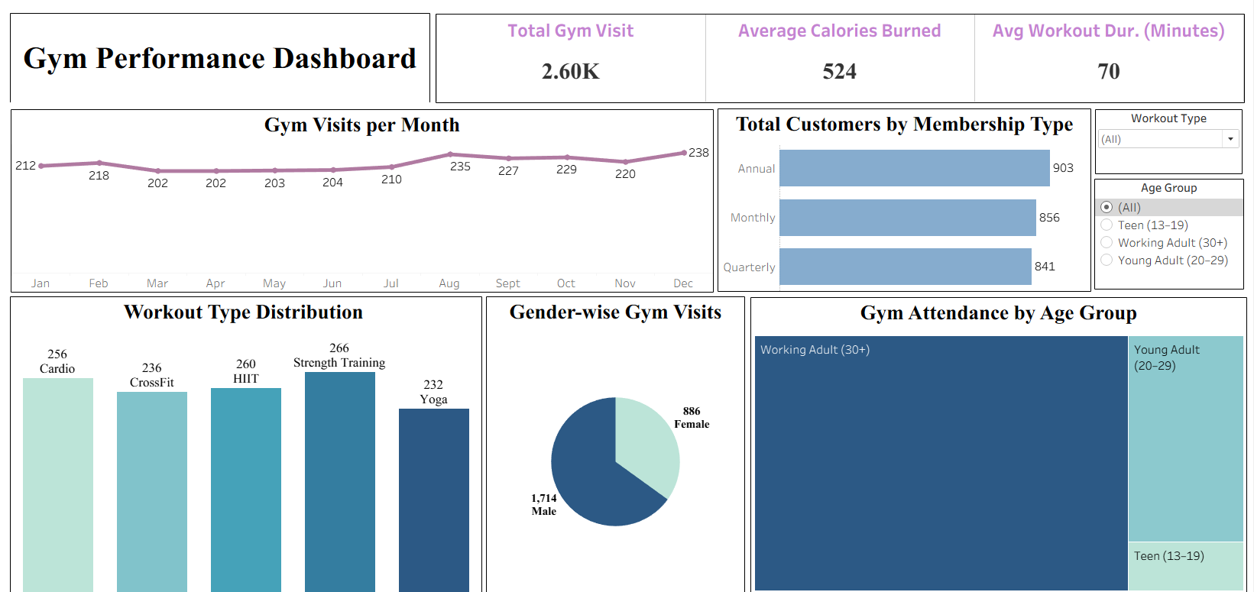
Dashboard

Slide 7
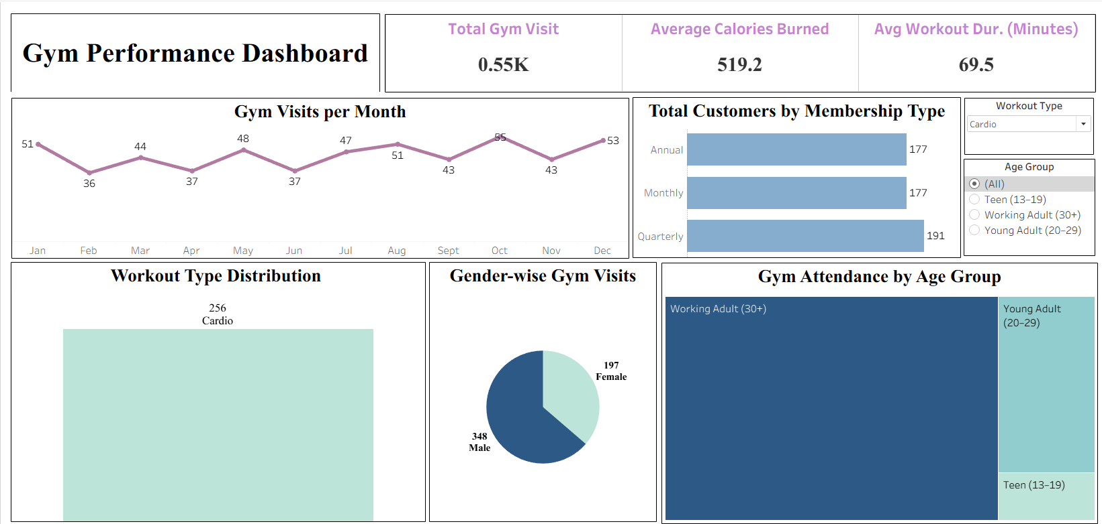
Using Filter

Slide 8
Future Scope
Integrate real-time or live gym data for continuous performance monitoring
Add revenue and membership renewal analysis for better business insights
Include customer retention and churn analysis
Track trainer performance and class-wise attendance
Enhance dashboard using advanced parameters and drill-down features
Expand analysis by comparing multiple gym branches
Use predictive analytics to forecast gym visits and member engagement

Slide 9
Conclusion
This project successfully demonstrates how raw gym data can be transformed into meaningful and actionable insights using data visualization. The interactive dashboard provides a clear understanding of gym performance, member demographics, workout preferences, and attendance trends.
By leveraging Tableau Public, this project supports data-driven decision-making and highlights the importance of effective dashboard design and data storytelling in business analytics.

Slide 10
THANK YOU

